Slide 1
Should We Go Retro?
Isaiah Crothers

Slide 2
Problem Statement
The CEO of the Chevrolet Motor Division, of General Motors Company, has reached out to go over and recall some vehicle specifications from a few decades back. The aim of the motor company at the moment is the push for a 50th anniversary, special line rollout of some of their older cars aesthetics, with newer technology. The car giant would like to see the differences in fuel efficiencies during the time, as well as weight and acceleration comparisons between the vehicles. Chevrolet would like to very much push forward the best and most efficient few vehicles for their new line.

Slide 3
Benefits of the Data

Slide 4
The Data

Slide 5
Methodology

Slide 6
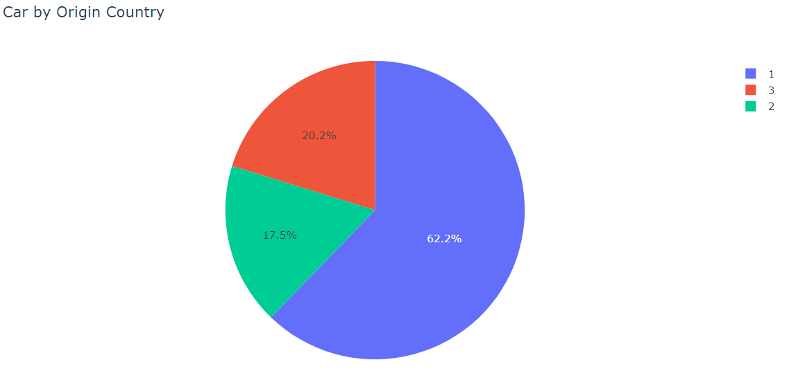
Data Findings
The first graph shows the total of all the cars within the dataset by their areas of Origin.
American made cars led the pack with 62% majority during this decade.
The European Market was the smallest slice of this pie, with 17.5%
The Asian market of manufacturing cars was the second largest market, compromising 20.2% of the overall cars with the specs sheets.

Slide 7
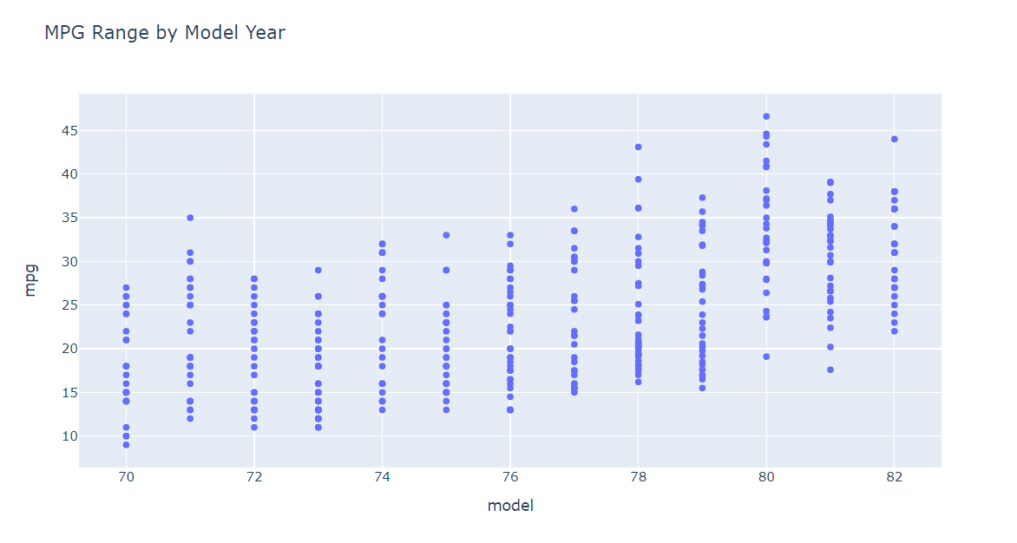
Miles Per Gallon
The general range of the MPG per model year a pretty gradual build in performance.
The best three model years per average were the years of 1980, 1981, 1982
The three years with the top highest MPG performance, were 1978, 1980, and 1982

Slide 8
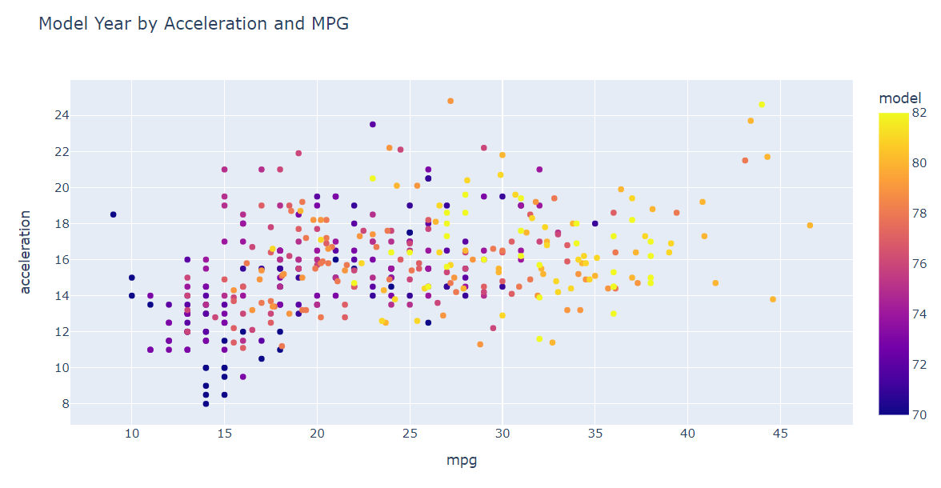
Data Continued
This graph is a representation of each car within the dataset, depicted by year, acceleration, and miles per gallon.
The general range of cars within the range of 1980-82, boast an impressive average MPG, alongside a higher average acceleration as well.
The lowest performing years came from around the early 70’s, with extremely low MPGs, with mild acceleration rates to accompany.
Within the top five highest MPG, four of the vehicles fall into the 1978 bracket.

Slide 9
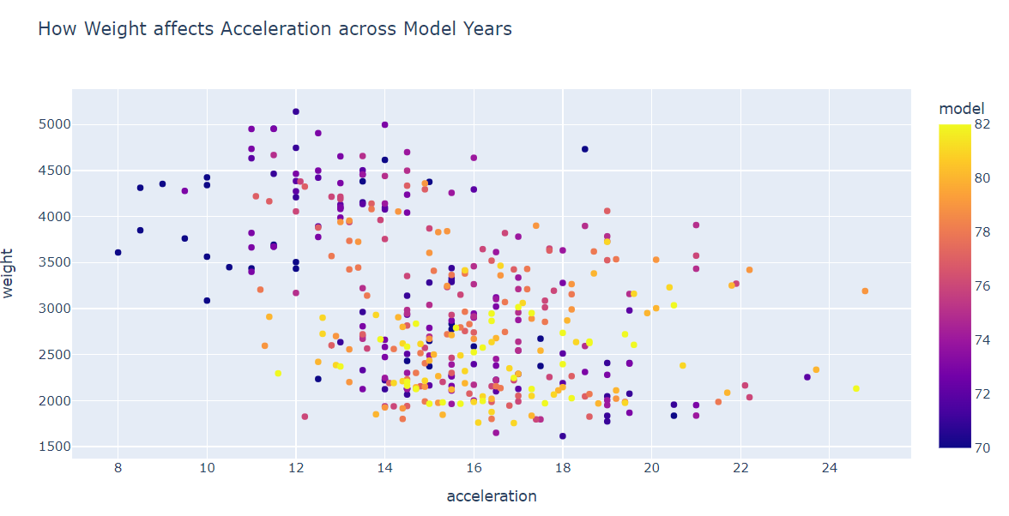
Weight v. Acceleration

Slide 10
Data Interpretation

Slide 11
Recommendations
To make a great year

Slide 12
Moving Forward

